Slide 1
Study of GPU Performance Characteristics
Peter deNoyelles
Matthew Michaelis
Matthew Sullivan
Bryant Wong

Slide 2
Outline
Objective
CPU and GPU architecture
Potential Research Bias
Brief history of GPU Architectures
Specific GPU Architectures
Current Benchmarks
Implementation Plan
References

Slide 3
Objective
At what calculation threshold is it more time efficient to use GPU rather than CPU?
At what threshold should we use multiple GPUs? Programs at scale
How much of the program must be pure calculations versus deterministic?

Slide 4
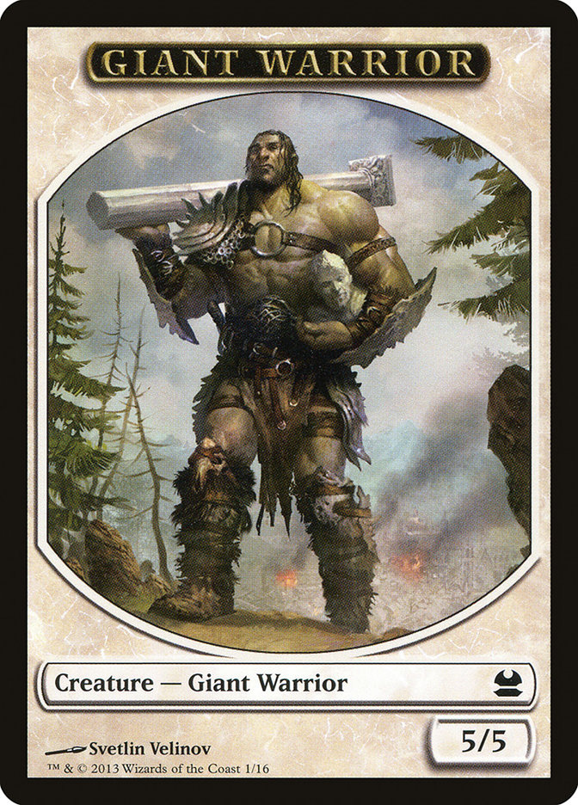

CPU vs. GPU Design and Limitations
“If a CPU is a giant warrior with rippling muscles and lighting reflexes, a GPU is an entire army of 20lb Smurfs carrying wooden swords.”
- Kiaran Ritchie, Principal Technical Animator at BioWare
VS
https://scryfall.com/card/tmma/1/giant-warrior
https://www.prexamples.com/2013/06/smurfs-invade-the-streets-of-rome/
Notes:
Matt Sullivan says smurfs are not allowed in the armed forces so there cannot be an army of smurfs

Slide 5
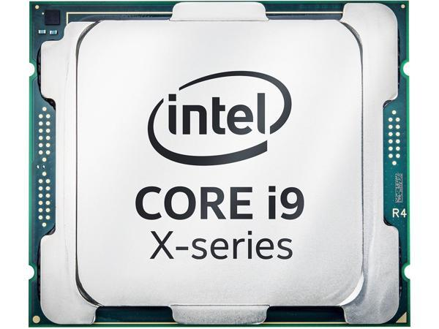
CPU General Features
Multiple instructions/multiple data (MIMD)
Handle multiple tasks sequentially by pipelining on single core
Clock speed generally high (up to 5 Ghz)
Interrupt handling
Can handle branch prediction, prefetching
Notes:
Basically everything we have learned in this class

Slide 6
CPU Limitations
Fewer number of cores (typically 4 to 8 but up to 24 on Heracles)
Utilizes system memory, shared across all applications, lower bandwidth (20-40 GB/s)
Power requirements per core
Branch prediction and prefetching capability leads to vulnerability to Spectre
Notes:
Lower memory bandwidth ~ 20-40 GB/s

Slide 7
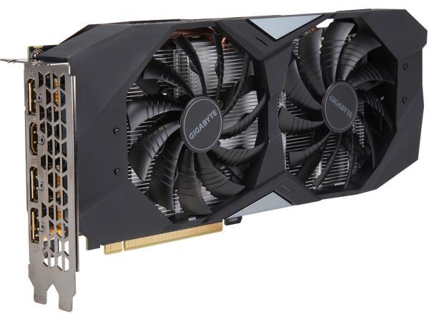
GPU General Features
Single instruction/multiple data (SIMD)
Handle calculations in parallel across cores
Significant multithreading per core
High number of cores (up to 512 per chip)
Dedicated memory, higher memory bandwidth (300+ GB/s)
Lacks branch prediction, prefetching, and out-of-order execution
Allows more processing power to compute floating point operations

Slide 8
GPU Limitations
Cannot handle interrupts
Lacks branch prediction, prefetching, and out-of-order execution
Lower overall clock speed (around 2 Ghz)

Slide 9
Potential Research Bias
Research by CPU manufacturers report only modest speed up when using GPUs (2.5x) (Lee et al. 2010)
Algorithms optimized for both GPUs and CPUs
Tested on high-throughput computing
Research by third party entities report much higher speed up (8-40x) with Fast Fourier transform on GPUs (Govindaraju et al. 2008)
Research by academic entities report orders of magnitude faster speed up (270-2700x) (Silberstein et al. 2008)
Other academics corroborate some findings (2.5-8x with matrix multiplication) (Dobravec & Bulic 2017)
Notes:
Lee et al. ALL INTEL CORP
Govindaraju et all ALL MICROSOFT
Silberstein (Israel university, UC davis)
Dobravec & Bulic (University of Ljubljana)

Slide 10
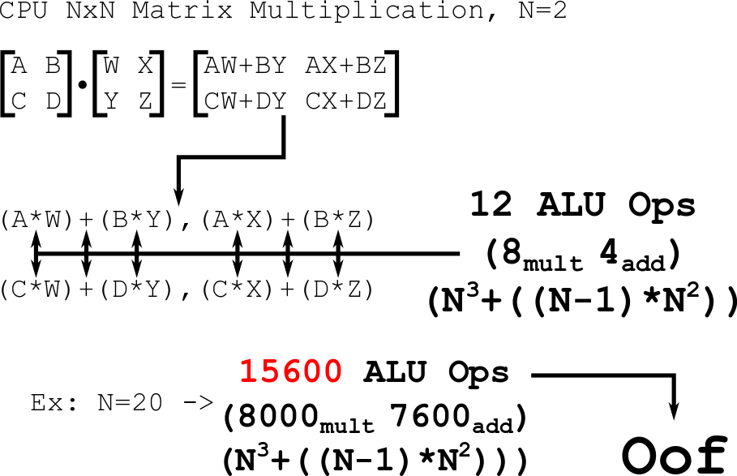

Slide 11
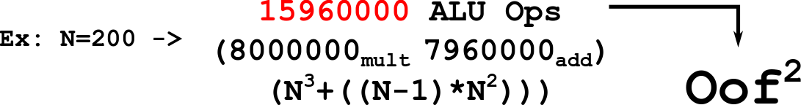

Slide 12
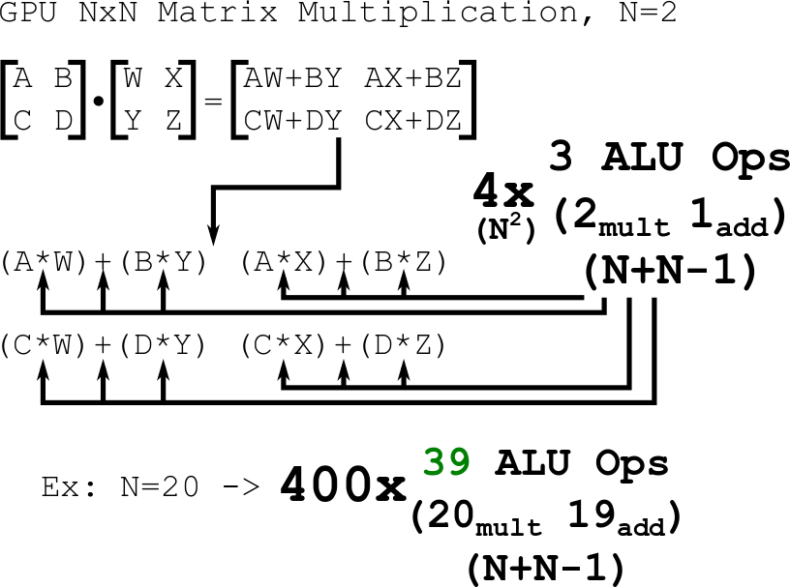

Slide 13
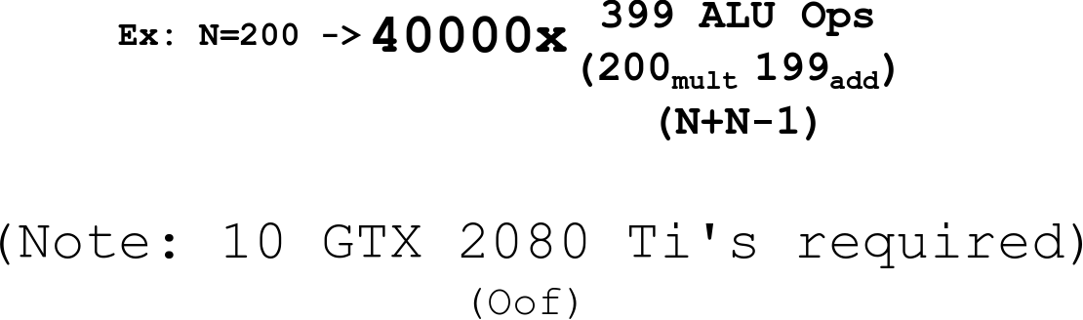

Slide 14
There's always a catch...
Concurrency is dependent on the number of threads available.
Number of Threads = T
So in short, why do we use GPUs for matrix multiplication?
Because 39 < 15600
So why don’t we always use GPUs for matrix multiplication?

Slide 15
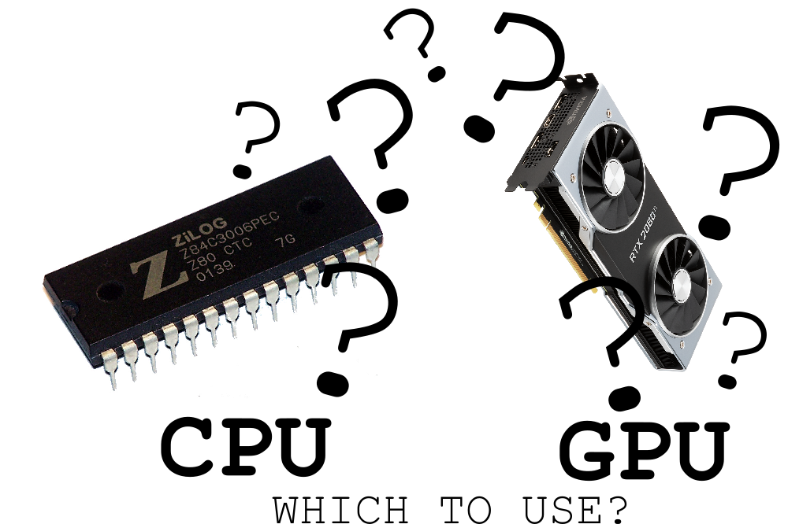
There's always a catch… Again.
GPU memory allocation, command processing, synchronization, and fetching completed results all have significant overhead.
It’s up to the programmer needs to decide if it's worth it to offload processing power to the GPU.

Slide 16
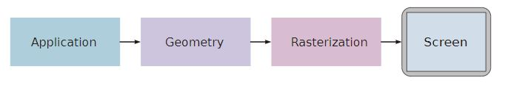
GPU Architecture: A Brief History
The Graphics Pipeline:
Each object is represented by 4 matrices, 3 rotational matrix and 1 translation matrix.
These matrices are then multiplied against the camera matrix for each object, resulting in the image on the display.
Since matrix multiplication is costly, dedicated cards were conceived to process in parallel with their own RAM were designed so as not to tax overall system resources.
Many of the steps are implemented in hardware, rather than software.
Notes:
The Graphics Pipeline is a conceptual way of interpreting 3d space onto a 2d display.
Application: Done by the CPU. Any change in the 3d space the display.
Geometry: Analyzing the 3d space and determining what is visible
Rasterization: Taking the visible items and translating them into pixels on the display.

Slide 17
GPU Architecture: A Brief History
1984 IBM Professional Graphics Controller (PGA) One of the first video cards to have a discrete processor on board.
1989 OpenGL introduced by SGI
1992 SGI RealityEngine introduced, multiple cores added for higher throughput (1 pixel per clock cycle)
1990’s more and more steps of the geometry portion transferred from CPU to GPU
1999 Geforce 256 “First GPU”
Programmable pipeline (GeForce3)
Exponential growth in processing power and number of cores.
More recent trends include adding flexibility and programmability to GPUs, while retaining the parallel processing power afforded by the multiple cores and hyperthreading

Slide 18
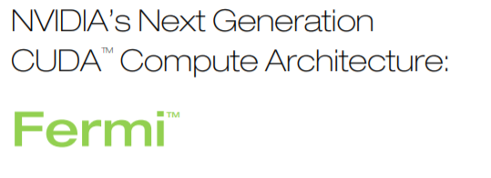
GPU Architecture: Fermi (40nm)
Used in Hydra
NVIDIA’s third generation SM (streaming multiprocessor)
14 per GPU
NVIDIA GigaThreadTM Engine
Improved Double Precision Performance
ECC Support
True CacheHeirarchy
Allowing access to GPU’s shared memory
Faster Atomic Operations
Dual Warp Schedulers
Notes:
Hydra: NVIDIA Tesla Fermi S2050 x1
Debut: 2009
Specific Core counts, RAM, etc. can be found on the GPU slides presented by Iris.
SM is the container fo the CUDA cores.
GigaThread Engine: 10x faster application context switching, Concurrent kernel execution, Out of Order thread block execution , Dual overlapped memory transfer engines.
ECC: error correcting code. ECC is used to protect data in memory. Support for this helps datacenter installations of these GPUs.
Users wanted faster atomic operations for parallel programs.

Slide 19
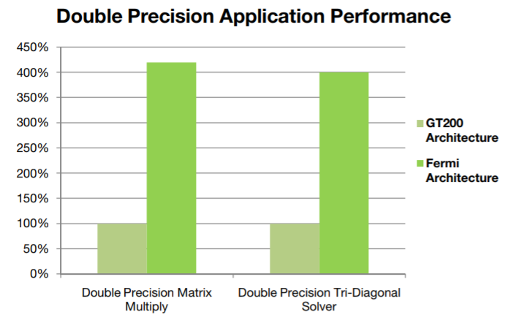
GPU Architecture: Fermi
Double Precision Focus
Linear Algebra
Numerical Simulation
Quantum Chemistry
Significant increase from previous GPU generation.
Notes:
-The increase is a result of directly targeting this feature.
-Fermi can perform up to 16 double precision multiply-add operations per SM, per clock.

Slide 20
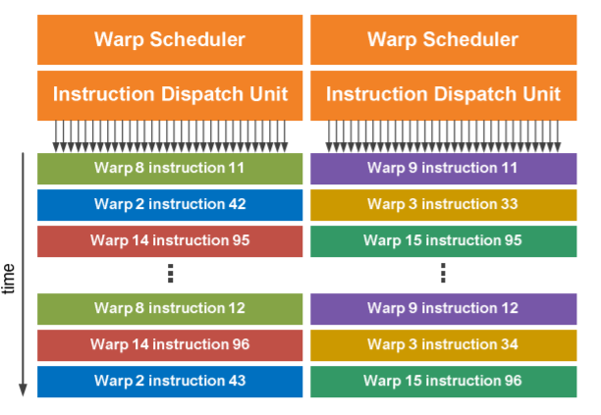
GPU Architecture: Fermi
Dual Warp Scheduler
32 threads per warp
Ints, FPs, or mix of int, FP, load, store, etc.
Instructions must be independent.
No documentation found on warp selection policy.
Notes:
-Warps are groups of threads. This is a hardware grouping, not software.
-Fermi groups them 32 threads per warp.
-Dual schedulers: as the name states, issuing two instructions per cycle to available warps.
Independent: need to be independent instructions from the same warp/instruction stream

Slide 21
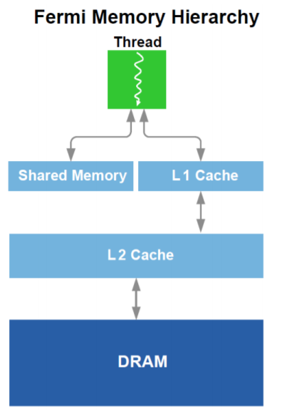
GPU Architecture: Fermi
Memory Hierarchy
Adapting cache hierarchy and shared memory
Traditional GPUs require read-only “load” path and write-only “export” path.
Not conducive to general purpose programs
Can create read after write hazard
Adaptive hierarchy attempts to solve this issue.
Shared memory for programs that require it (electrodynamic simulations)
Cache for arbitrary programs where memory access is not known beforehand.
Notes:
Load path is for texture operations
Export path is for pixel data output.
Shared Memory and Cache size are configurable

Slide 22
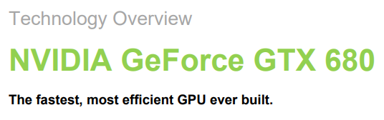
GPU Architecture: Kepler (28nm)
Used in Dozer
Updated SMs
8 per GPU
Power Efficiency
GPC (Graphics Processing Cluster)
32 pixels per cycle
SMX architecture (updated SMs)
8 per GPU
Notes:
Dozer:Nvidia K40c x1
Debut: 2012

Slide 23
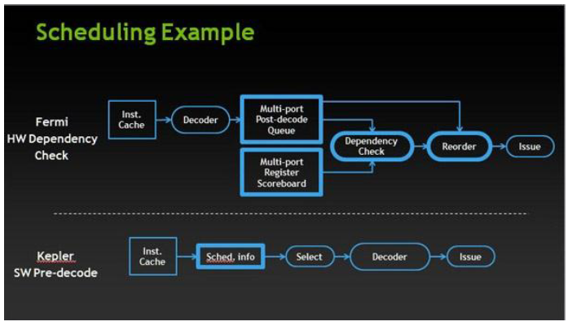
GPU Architecture: Kepler
Each SM has 4 warp schedulers (2 warps per cycle)
Multi-port Register Scoreboard
Keeps track of registers not yet ready with valid data
Dependency Check
Analyze register usage across fully decoded war instruction against scoreboard
This info is deterministic
Compiler can determine upfront when instructions will be ready to issue
Sched. Info block extracts pre-determined latency info and uses it to determine warp eligibility,

Slide 24
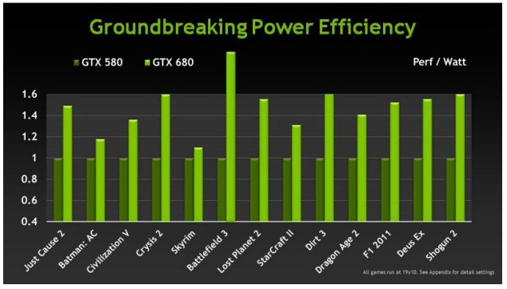
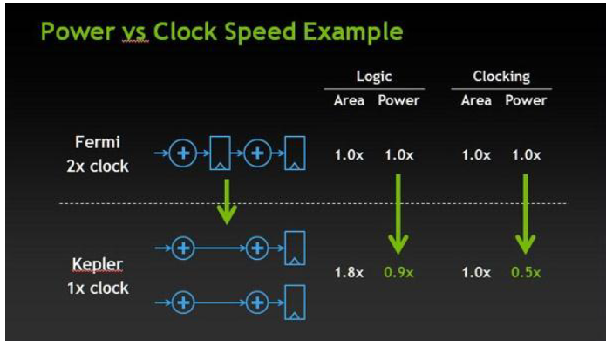
GPU Architecture: Kepler
Just look at that efficiency!
Final part to updated SM is the PolyMorph Engine
Delivers roughly double the per-clock performance
30% high clock speed

Slide 25
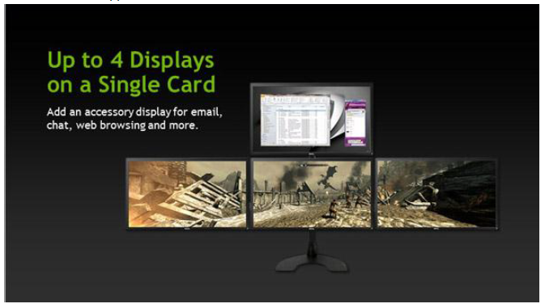
GPU Architecture: Kepler
Many display/video engine updates that we won’t be using

Slide 26
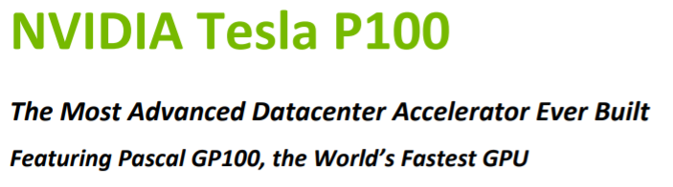
GPU Architecture: Pascal (16nm)
Used in Heracles
Increased SM count
60 per GPU
Focus on High Performance Computing, Deep Learning, and AI
High Speed bandwidth
CPU to GPU
GPU to GPU
Updated memory architecture
HBM2 (High Bandwidth Memory, 2nd Gen.)
Unified Memory
Compute Preemption
Notes:
Heracles: NVIDIA Tesla P100 x4
Debut: 2016
3 generations later than Fermi (Kepler and Maxwell inbetween)
-HMB2: High Bandwidth second gen. Stacked mem located on same physical package as GPU
-Unified Mem: unified virtual address space for CPU and GPU mem. This simplifies GPU programming as we no longer need to manage data sharing between two
Compute Preemption: prevents long-running apps from monopolizing the GPU or timing out. Auto schedules other tasks in GPU so programmer does not have to account for this.

Slide 27
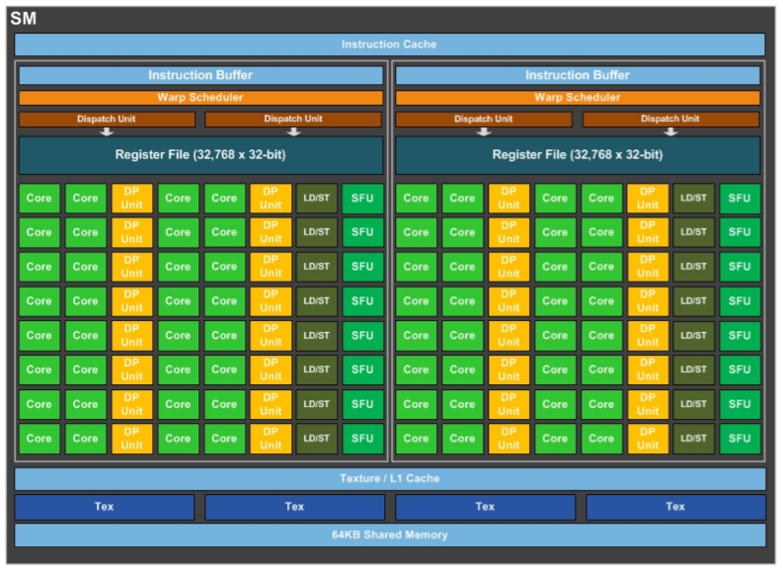
GPU Architecture: Pascal
Warp Scheduler
Same Dual scheduler as Fermi
Improved Scheduling
Less Power Consumption
Support for FP16
Less precision required for deep neural networks.
Less precision allows larger networks to train on these GPUs.
5.3 TFLOPS of double precision floating point (FP64) performance
10.6 TFLOPS of single precision (FP32) performance
21.2 TFLOPS of half-precision (FP16) performance
Notes:
Scheduling: scheduling seems to a be a trade secret. Not documented.
Iris provided this slide but just wanted to point out that the warp scheduler is still dual. Just improved scheduling.
2x performance speed up compares to FP32. Also takes less transfer time.
TFLOP: terraflop. Trillions of floating point operations per second

Slide 28
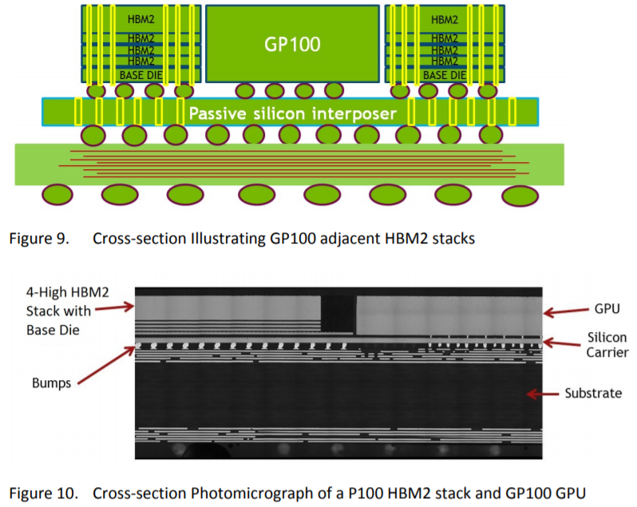
GPU Architecture: Pascal
HBM2 Stacked Memory
Higher memory capacity and bandwidth
Allows up to 8 DRAM dies per stack
Notes:
Dies Per stack: as opposed to 4 in the first generation

Slide 29
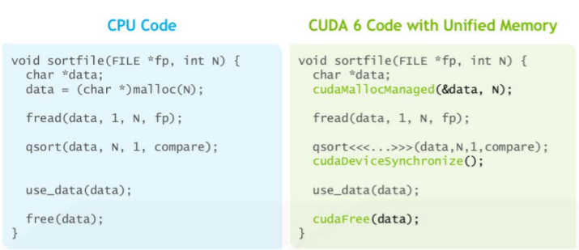
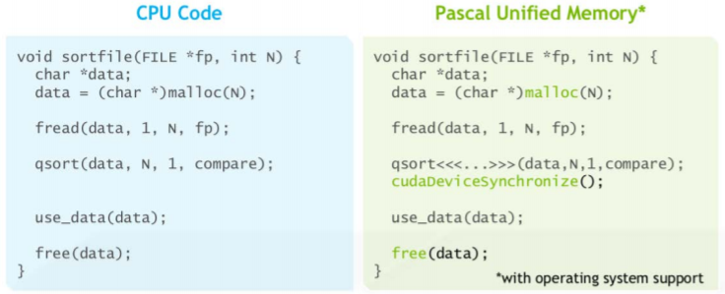
GPU Architecture: Pascal
Unified Memory
Previously, illegal due to scenario of CPU accessing Unified Memory while GPU kernel was active.
Still need to ensure synchronization to avoid data hazards.
Notes:
Simpler programming and memory model.
Lowers bar of entry to parallel programming on GPUs
Memory management optional for optimization but not required.

Slide 30
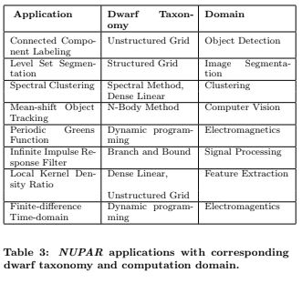
Current Benchmarks
NUPAR: A suite of 8 applications designed to mimic real world
problems
Each application tests a specific aspect of modern GPUs,
Denoted by its Dwarf Taxonomy.

Slide 31
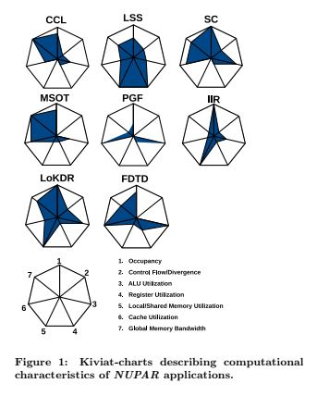
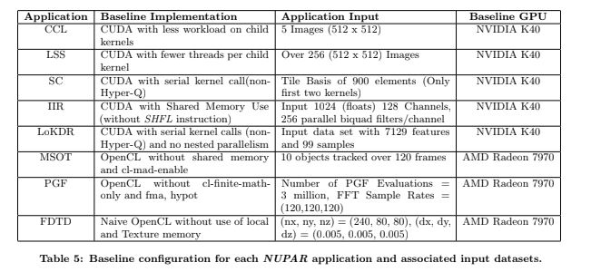
NUPAR Examples

Slide 32
Implementation Plans
Matrix Multiplication, FFT, and Sorting Algorithm performance Benchmarks
CPU vs GPU Performance
GPU vs GPU Performance
Deep dive into performance differences
Reasons for any drastic differences
Exploring bottlenecks

Slide 33
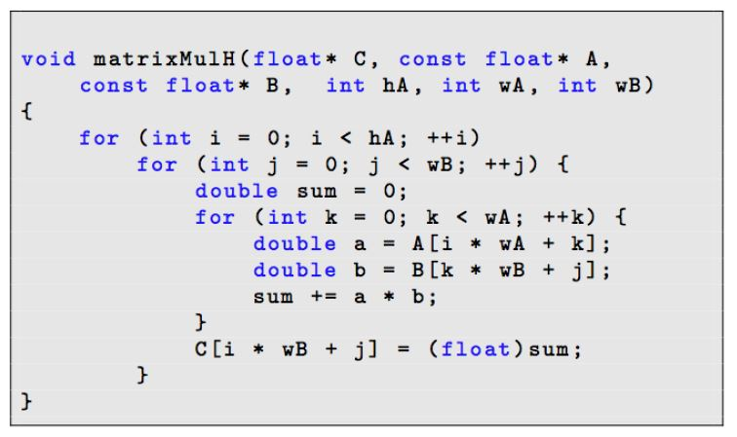
CPU vs GPU Performance
Matrix multiplication
Sequential on CPU
In parallel on GPU with system memory
In parallel on GPU with shared memory
FFT
Sorting
At what efficiency threshold do we switch from CPU to GPU?
Same for GPU vs GPU
Dobravec & Bulic, 2017

Slide 34
References
VW Lee, C Kim, J Chhugani et al. (June 2010). “Debunking the 100x GPU vs. CPU myth: An evaluation of throughput computing on CPU and GPU .” International Society for Computers and their Applications (ISCA).
M Silberstein, A Schuster, D. Geiger et al (June 2008). “Efficient computation of sum-products through software-managed cache.” International Conference on Supercomputing.
NK Govindaraju, B Lloyd, Y Dotsenko et al (November 2008). “High performance discrete Fourier transforms on graphics processors,” Proceedings of the ACM/IEEE Conference on Supercomputing.
T Dobravec & P Bulic. (July 2017). “Comparing CPU and GPU implementation of a simple matrix multiplication algorithm.” International Journal of Computer Electrical Engineering.
McClanahan, Chris (2011) “History and Evolution of GPU Architecture, A Paper Survey”
NVIDIA, (2008). “Whitepaper NVIDIA’s Next Generation CUDA Compute Architecture: Fermi”
NVIDIA, (2012). “Technology Overview NVIDIA GeForce GTX 680”
NVIDIA, (2016). “Whitepaper NVIDIA Tesla P100”

